Slide 1

Twitter Image and Text Data Analysis for identifying Derogatory Posts
Under the guidance of
Dr. Jaya Sil
Presented by
Devtanu Misra (510519009)
Anish De (510519010)
Ahel Das Chatterjee (510519028)
Malay Gain (510519033)
Sounak Majumder (510519068)
Sayak Rana (510519108)
Department of Computer Science & Technology

Slide 2
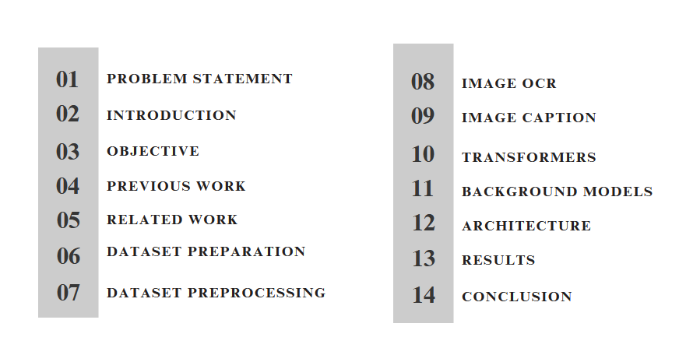
CONTENTS

Slide 3

PROBLEM STATEMENT
To develop an automated system that can analyze tweets (Twitter posts) and determine whether a given post is derogatory or not.
To prepare a multimodal(Image + Text) and multilingual dataset with relevant twitter posts.
To propose an architectural pipeline that combines the image and text, process the data and classify them.

Slide 4

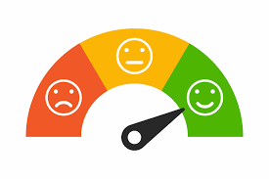
INTRODUCTION
Social media platforms have become essentials of our daily routine and twitter is one of them.
Twitter posts need to be analysed and checked whether derogatory or not.
Multimodal(image & text), Multilingual(English+ Hindi) approach has to be used as twitter data contains both image and text.
There is scarcity of dataset that contains recent twitter data in required format.
Deep Learning frameworks based on Transformer models can be used to prepare the solution.

Slide 5
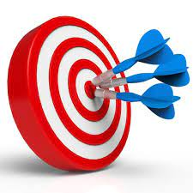
OBJECTIVE
Need to identify whether a post is derogatory or not in context with the escalating malicious conduct on social media.
Most State of the Art models focus on text or image separately.
A new dataset has to be prepared that can be used for twitter sentiment analysis.
Previous textual work to be enhanced by combining both image and texts i.e, in a multimodal fashion.

Slide 6

PREVIOUS SEMESTER WORK
Survey to understand what works had been done in the field of sentiment analysis.
Preliminary Dataset to do sentiment analysis.
Purely text based architecture to carry out sentiment analysis experiments.
Comparison of Transformer networks with CNN,LSTM in context with the results obtained.

Slide 7
RESULTS FROM PREVIOUS SEMESTER
 | Accuracy | Precision | Recall | F1 Score
BERT | 0.72 | 0.71 | 0.71 | 0.71
AlBERT | 0.73 | 0.69 | 0.68 | 0.69
DistilBERT | 0.72 | 0.65 | 0.65 | 0.65
LSTM | 0.62 | 0.46 | 0.50 | 0.53

Slide 8
RELATED WORK
AUTHOR | PAPER NAME | CONTRIBUTION
Ullah MA, Syeda M, Begum SA, Dipa NS | An algorithm and method for sentiment analysis using the text and emoticons from social media data. | Textual analysis using machine learning and deep learning algorithms
Zhang Y, Sun J, Meng L, Liu Y. | Sentiment analysis of e-commerce text reviews based on sentiment dictionary. | Improved the accuracy of the textual analysis
Jitendra V. Tembhurne1 & Tausif Diwan1 | Sentiment analysis in textual, visual and multimodal inputs using recurrent neural networks. | Earliest works on multimodal datasets
Aria Naseri Karimvand, Reza Salehi Chegeni, Mohammad Ehsan Basiri , Shahla Nemati . | Sentiment analysis in textual, visual and multimodal inputs using recurrent neural networks. | Worked on neural networks and further improved the accuracy
Sani Kamış , Dionysis Goularas | Evaluation of Deep Learning Techniques in Sentiment Analysis from Twitter Data. | Employed deep learning approaches

Slide 9
PROPOSED WORK
Dataset Preparation -
Consider a post derogatory or not based on 4 categories namely - Profane, Targeted Insult, Sentiment and Hate Speech.
Manually determine the classes for each post.
Data Scraping - Scrape data from twitter to prepare a dataset consisting of multilingual posts - posts in Hindi, English and Bengali.
Each post can contain an image and text entity.
Image Caption and Image OCR - Use the post image to extract text OCR as well image caption, and push them into our dataset.
Model Building -
Model Architechture- Feed the text and image instance to classify the post.
Train the model - Use the newly created dataset to train our model.
Predict unknown data - Use our model to categorize the nature of unknown data, and label them as derogatory or not.

Slide 10
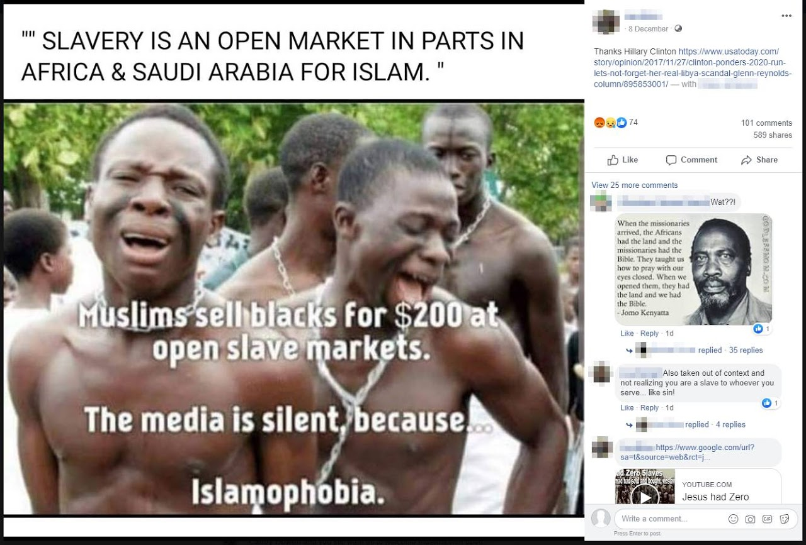
INITIAL DATASET : SENTWEET VERSION 1
Here’s the description of the first version of dataset:
POST_ID: A unique ID associated with each post
POST_LINK: Twitter post link
Text: The caption obtained from the post
Text Type: Could be Caption, Image OCR or Image Caption.
MEDIA_URL: The url where the associated media files are hosted.
Language: English and Hindi
Hate Speech, Profane, Targeted Insult, Sentiment: Manually annotated classes
Derogatory: Target class
Image Caption: A man is crying
Image OCR: Slavery is an open market in parts in Africa & Saudi Arabia for Islam. Muslims sell blacks for $200 at open slave markets. The media is silent, because… Islamophobia.

Slide 11
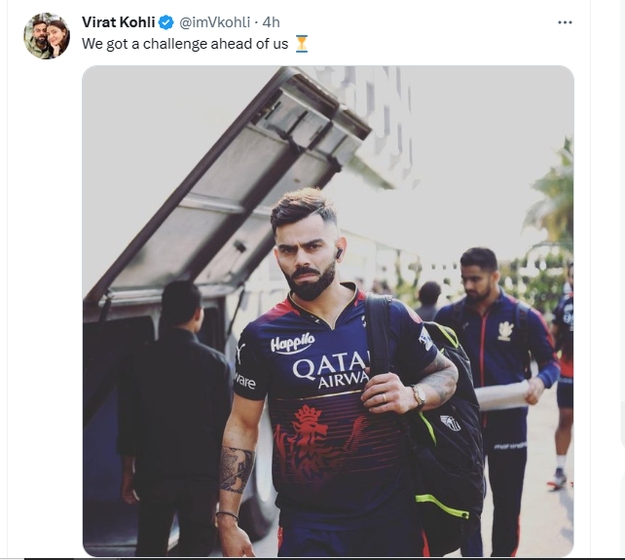
DATASET PREPARATION
Here’s how we prepared our dataset:
We scrapped the data using Twitter APIs provided by Twitter Developer Account
For the image instance we passed the image portion to the model and for the text instance we concatenated all the text caption with image caption and image ocr.
Manually annotated the posts as derogatory or not.
Images downloaded in a single folder using the media url extracted in previous step.
Algorithms and models for extracting image OCR and image captions were run on the files in this folder.
Added synthetic data to balance the dataset with derogatory texts and images.
Around 3000 data points in our dataset.

Slide 12
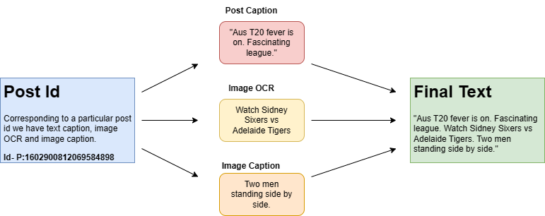
PREPROCESSING THE DATASET
Here’s the steps we followed to create the final version:
Combine the texts from the rows having same ID.
Tokenize the text column in each row.
For example, “This is bad business” becomes “This”, “is”, “bad”, “business”.
Remove stopwords, like “a”, “an”, “the”, “you”, etc.
Stopwords are those words which are used too frequently in a language and are usually ignored by search engines while searching for results.
For example, “This”, “is”, “bad”, “business” becomes “bad”, “business”.
Use these tokens for predicting the class “Derogatory”.

Slide 13
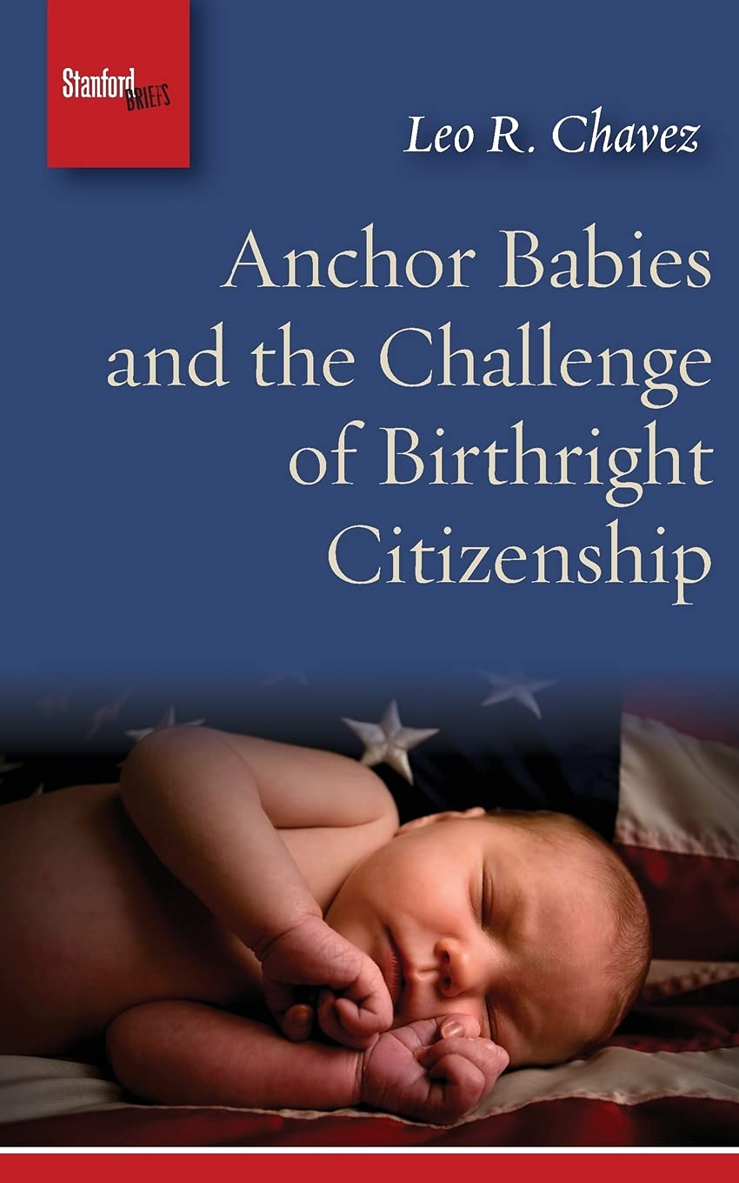
FINAL DATASET: SENTWEET VERSION 2
Here’s how we prepared our dataset:
Text : The actual post texts, along with hashtags, emojis, etc concatenated with image caption, OCR of the image associated with the post.
IMAGES_ID : Contains file name of the image associated with the post downloaded in a specific folder.
Derogatory : Whether the post is carrying some negative sentiment or profane or hate speech or targeted insult. Might be YES or NO
sounak_images 7.jpg

Slide 14
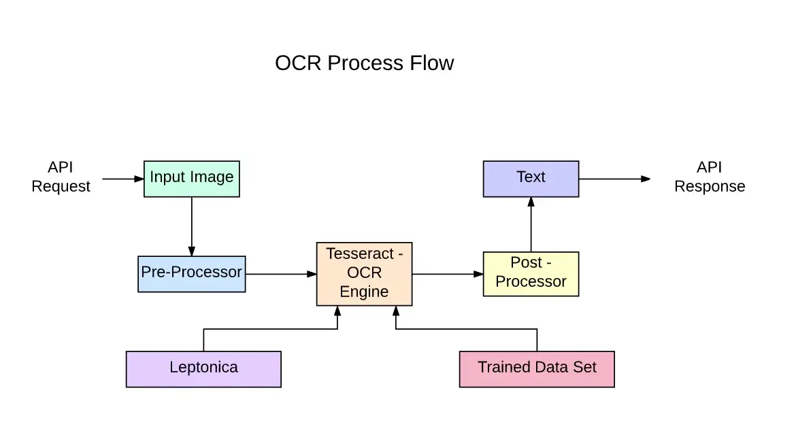
IMAGE OCR
Pytesseract tool has been used for converting image-text to text.
It can read all image types including jpeg, png, gif, bmp, tiff, and others.
It has unicode (UTF-8) support, and can recognize more than 100 languages "out of the box".
Pytesseract is actually a wrapper class or a package for Google’s Tesseract-OCR Engine.
Based on LSTM neural network.

Slide 15

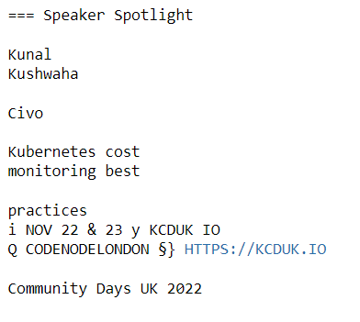
IMAGE OCR - EXAMPLE
Sample Image Input:
Sample OCR Output from Model:

Slide 16
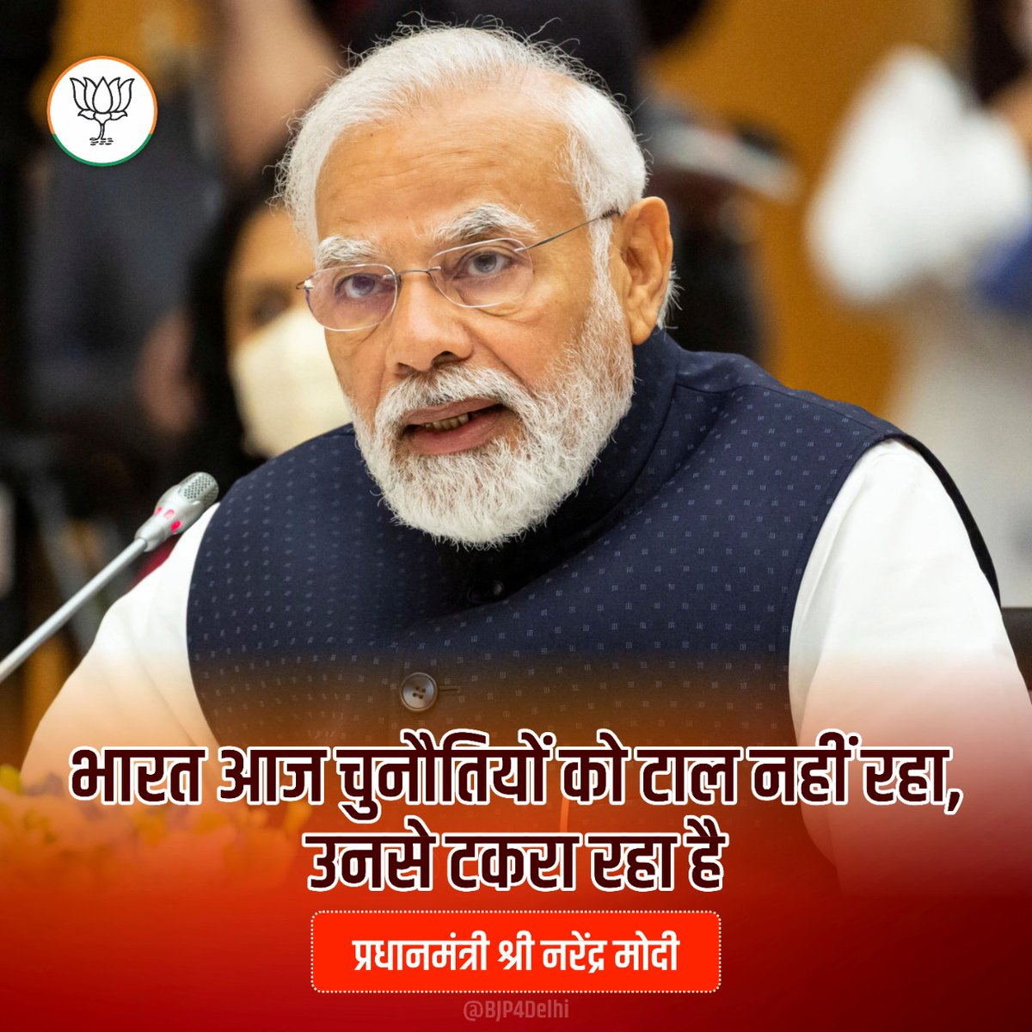
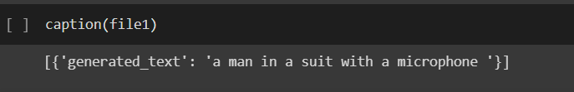
IMAGE CAPTIONING
Sample Image Input:
Image Captioning is the process of generating textual description of an image.
We are basically using a pre-trained (already trained on some dataset) Image Captioning Model, namely ViT-Roberta model as a pipeline.
After that we are finetuning it with the Flickr Dataset and lastly testing it with the images extracted from twitter posts and generating respective captions.
Sample Output from Model:
a man in a suit with a microphone

Slide 17
IMAGE CAPTIONING
Pretrained Image Captioning (ViT-Roberta) Model
Finetuning using Flickr Dataset
Twitter image dataset
Generate Captions
The ViT Roberta model is a state-of-the-art language model that combines the transformer architecture of BERT with the vision transformer architecture.
It has achieved top performance on a wide range of natural language processing tasks, including question answering, sentiment analysis, and language modeling, image captioning.

Slide 18
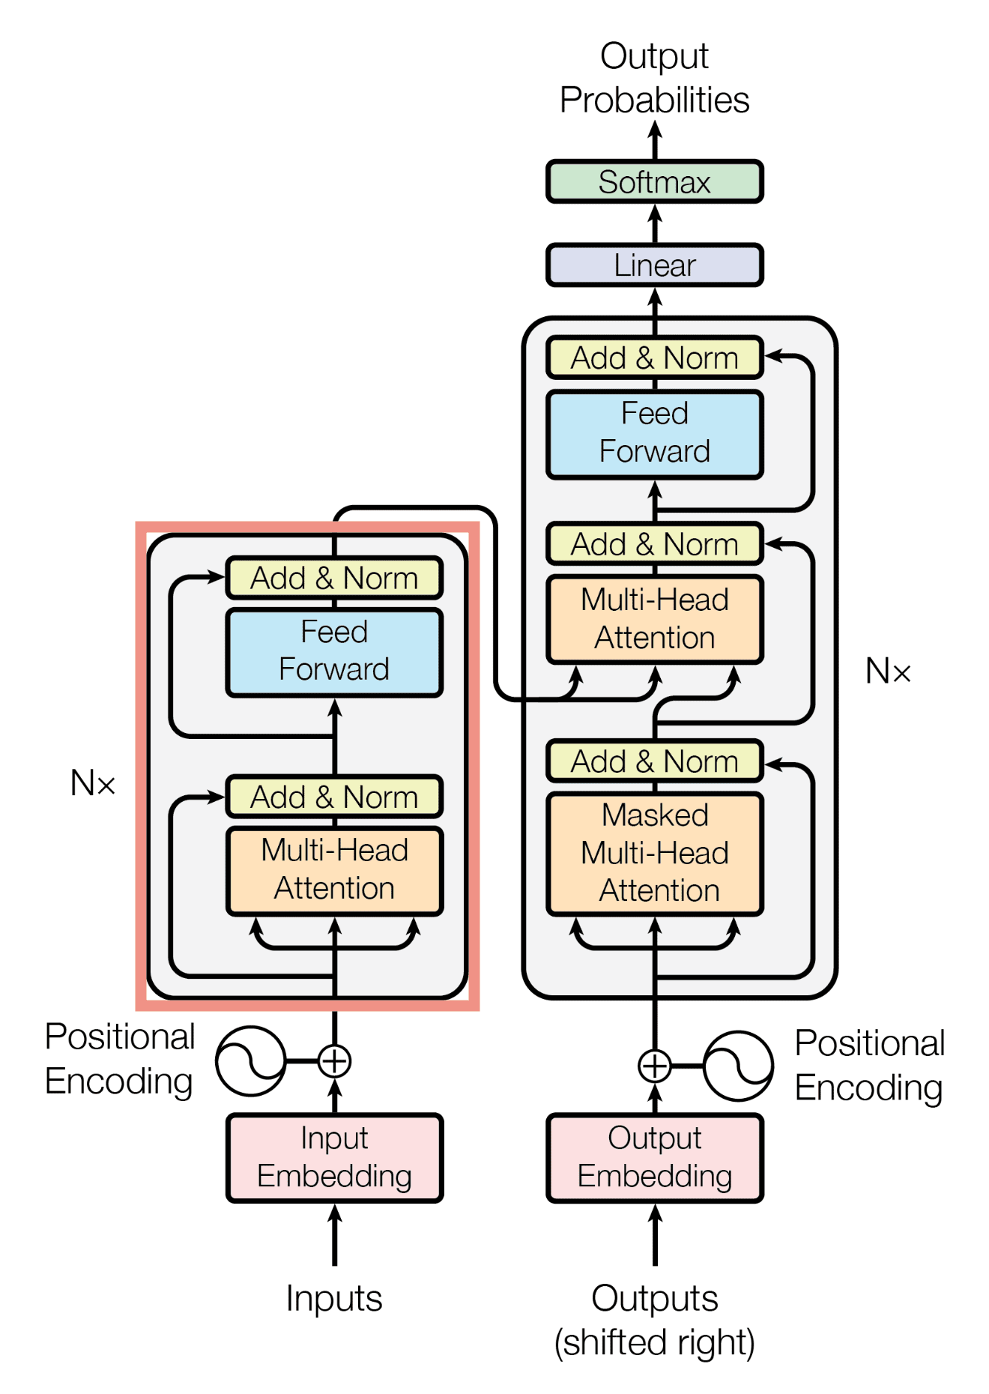
TRANSFORMERS
A transformer is a deep learning model that adopts the mechanism of self-attention, differentially weighting the significance of each part of the input data.
Non-sequential - Transformers process sentences as whole.
Self attention - Used to find similarity scores between words in a sentence.
Brings to power of bidirectional RNNs to get past and future data.

Slide 19
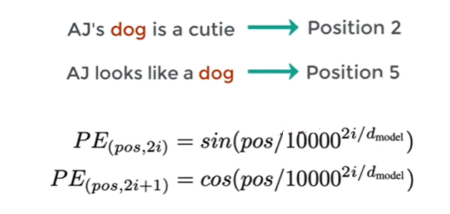
POSITIONAL ENCODERS
Vector that gives context based on position of word in sentence.

Slide 20

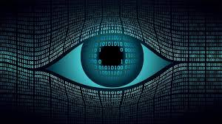
BACKGROUND MODELS USED
The background models used for this project are
BERT model and its variations.
Vision Transformer.
Some variations of BERT model like ALBERT, ROBERTA, DISTILBERT and variation of VIT model like BEIT model have been used for comparison.

Slide 21
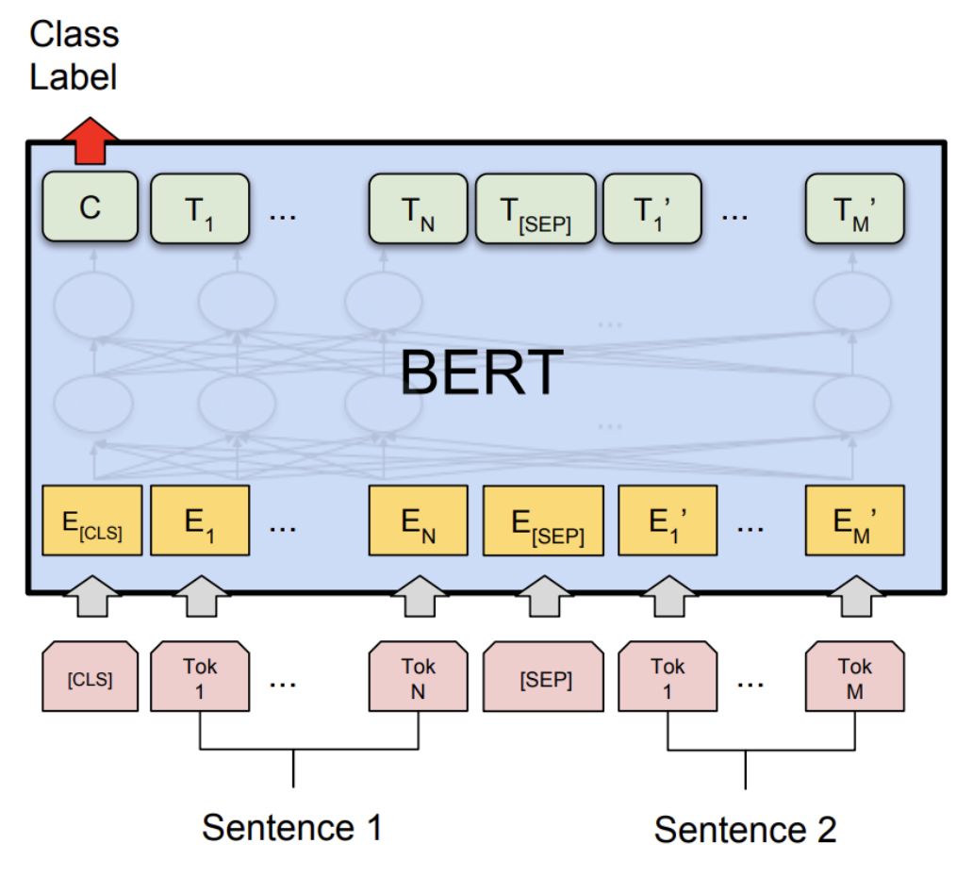
BERT MODEL
Bidirectional Encoder Representations from Transformers.
Bidirectional Context: BERT is designed to understand the meaning of a word within the context of both its preceding and succeeding words.
Pretraining on Large Corpus: BERT is pretrained on a large corpus of unlabeled text data, such as Wikipedia articles or books.
Masked Language Model (MLM): It randomly masks out some words in the input text, and the model's task is to predict the masked words based on the surrounding context.

Slide 22
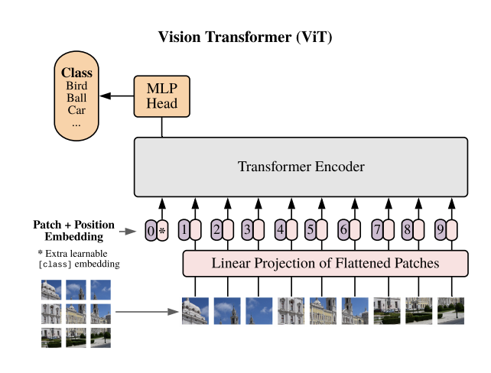
VIT MODEL
The Vision Transformer, or ViT, is a model for image classification that employs a Transformer-like architecture over patches of the image.
An image is split into fixed-size patches, each of them are then linearly embedded, position embeddings are added, and the resulting sequence of vectors is fed to a standard Transformer encoder.
In order to perform classification, the standard approach of adding an extra learnable “classification token” to the sequence is used.

Slide 23
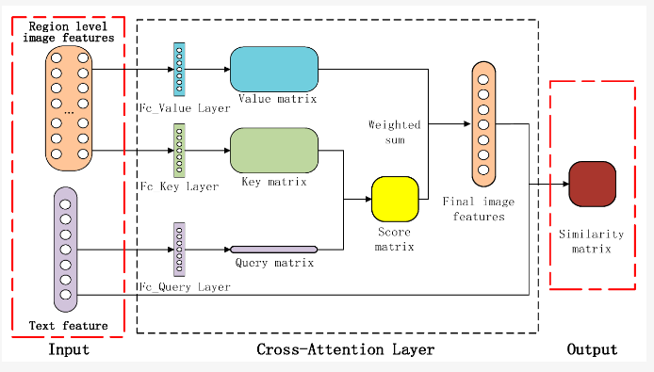
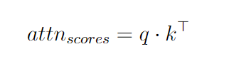
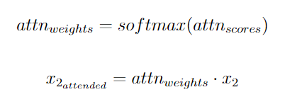
CROSS MODAL ATTENTION LAYERS
Cross-attention is a technique used in transformer-based models to combine information from two different modalities, such as text and image.
Steps in cross attention:
Query and Key Generation
Calculate Attention Scores
Compute Attention Weights
Residual Connection and Linear Layer: The attended tensor x2 attended is added to the input tensor x1 using a residual connection.
Output of the residual connection is passed through a linear layer to generate the final output tensor out.

Slide 24
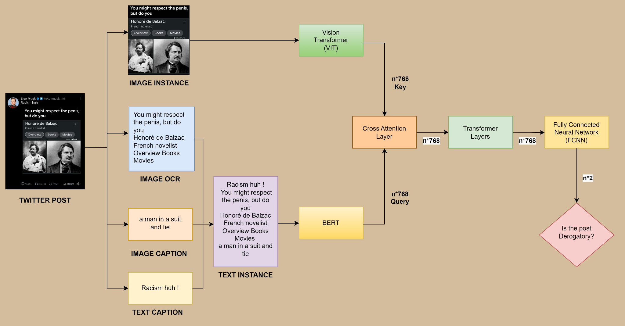
PROPOSED WORK - ARCHITECTURE
Yes
No

Slide 25
COMPARISON OF DIFFERENT VARIATIONS OF BERT & VIT
 | Accuracy | Precision | Recall | F1 Score
BERT + VIT | 0.87 | 0.88 | 0.85 | 0.87
AlBERT + VIT | 0.85 | 0.87 | 0.82 | 0.84
DistilBERT + VIT | 0.87 | 0.88 | 0.85 | 0.87
AlBERT + BEIT | 0.72 | 0.56 | 0.50 | 0.53

Slide 26
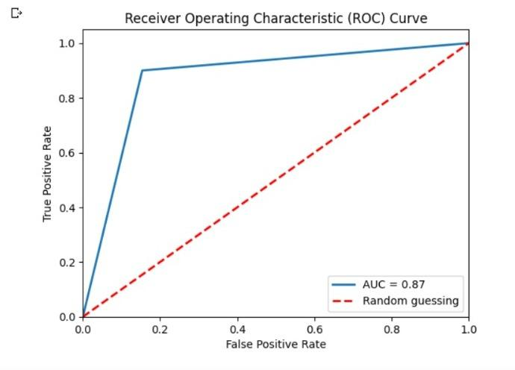
AUC ROC - BERT + VIT

Slide 27
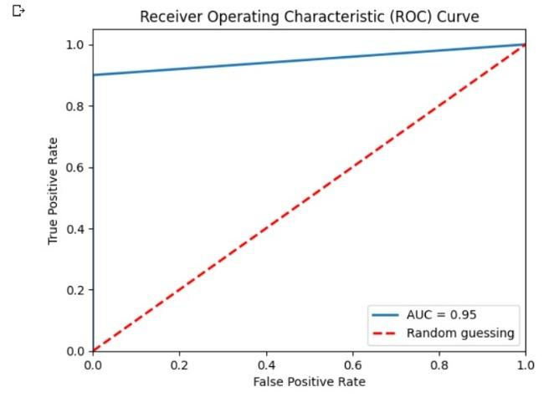
AUC ROC - BERT + VIT (Epoch = 5)

Slide 28
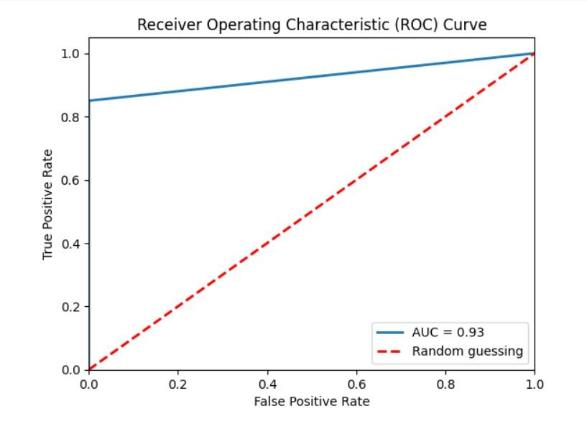
AUC ROC - AlBERT + VIT

Slide 29
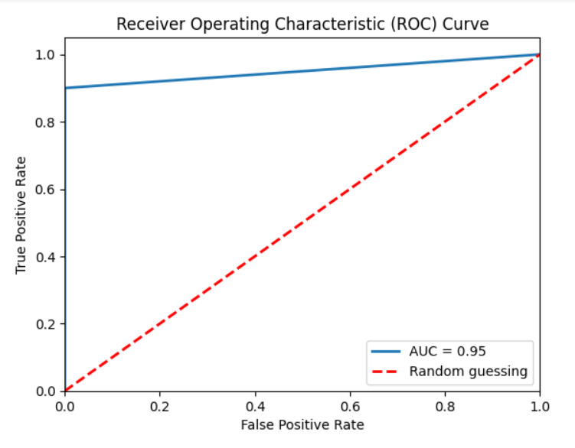
AUC ROC - DistilBERT + VIT

Slide 30
CONCLUSION
According to the work done till now, we found -
Regarding observation, we observed that BERT or DistilBERT combined with VIT gave the best results.
When VIT was replaced by other image based transformer models, results deteriorated drastically. This shows that images have great significance in determining label of a post.
Accuracy, Precision, Recall can be improved using a larger size dataset.
Learning and decoding emojis, videos and more languages can further improve the model.

Slide 31
REFERENCES
Ullah et al. An algorithm and method for sentiment analysis using the text and emoticons from social media data.
Zhang et al. Sentiment analysis of e-commerce text reviews based on sentiment dictionary.
Jitendra et al. Sentiment analysis in textual, visual and multimodal inputs using recurrent neural networks.
Aria Naseri Karimvand et al. Sentiment Analysis of Persian Instagram Post: a Multimodal Deep Learning Approach.
Sani Kamış et al Evaluation of Deep Learning Techniques in Sentiment Analysis from Twitter Data.
Vaswini et al. Attention is all you need.
https://medium.com/@kalpeshmulye/image-captioning-using-hugging-face-vision-encoder-decoder-step-2-step-guide-part-1-495ecb05f0d5
https://huggingface.co/blog/sentiment-analysis-python
https://nanonets.com/blog/ocr-with-tesseract/
https://medium.com/@raman.shinde15/image-captioning-with-flickr8k-dataset-bleu-4bcba0b52926

Slide 32
THANK YOU!!

